Slide 1
Cyclist Bike Trip Insights
Presented by: Ajay Chaudhary
Last updated : 2022/01/02

Slide 2
Table Of Content
Objective
Number of rides by weekday
Average duration by weekday
Conclusion

Slide 3
Objective
How do causal members and annual members choose cyclist bike differently ?

Slide 4
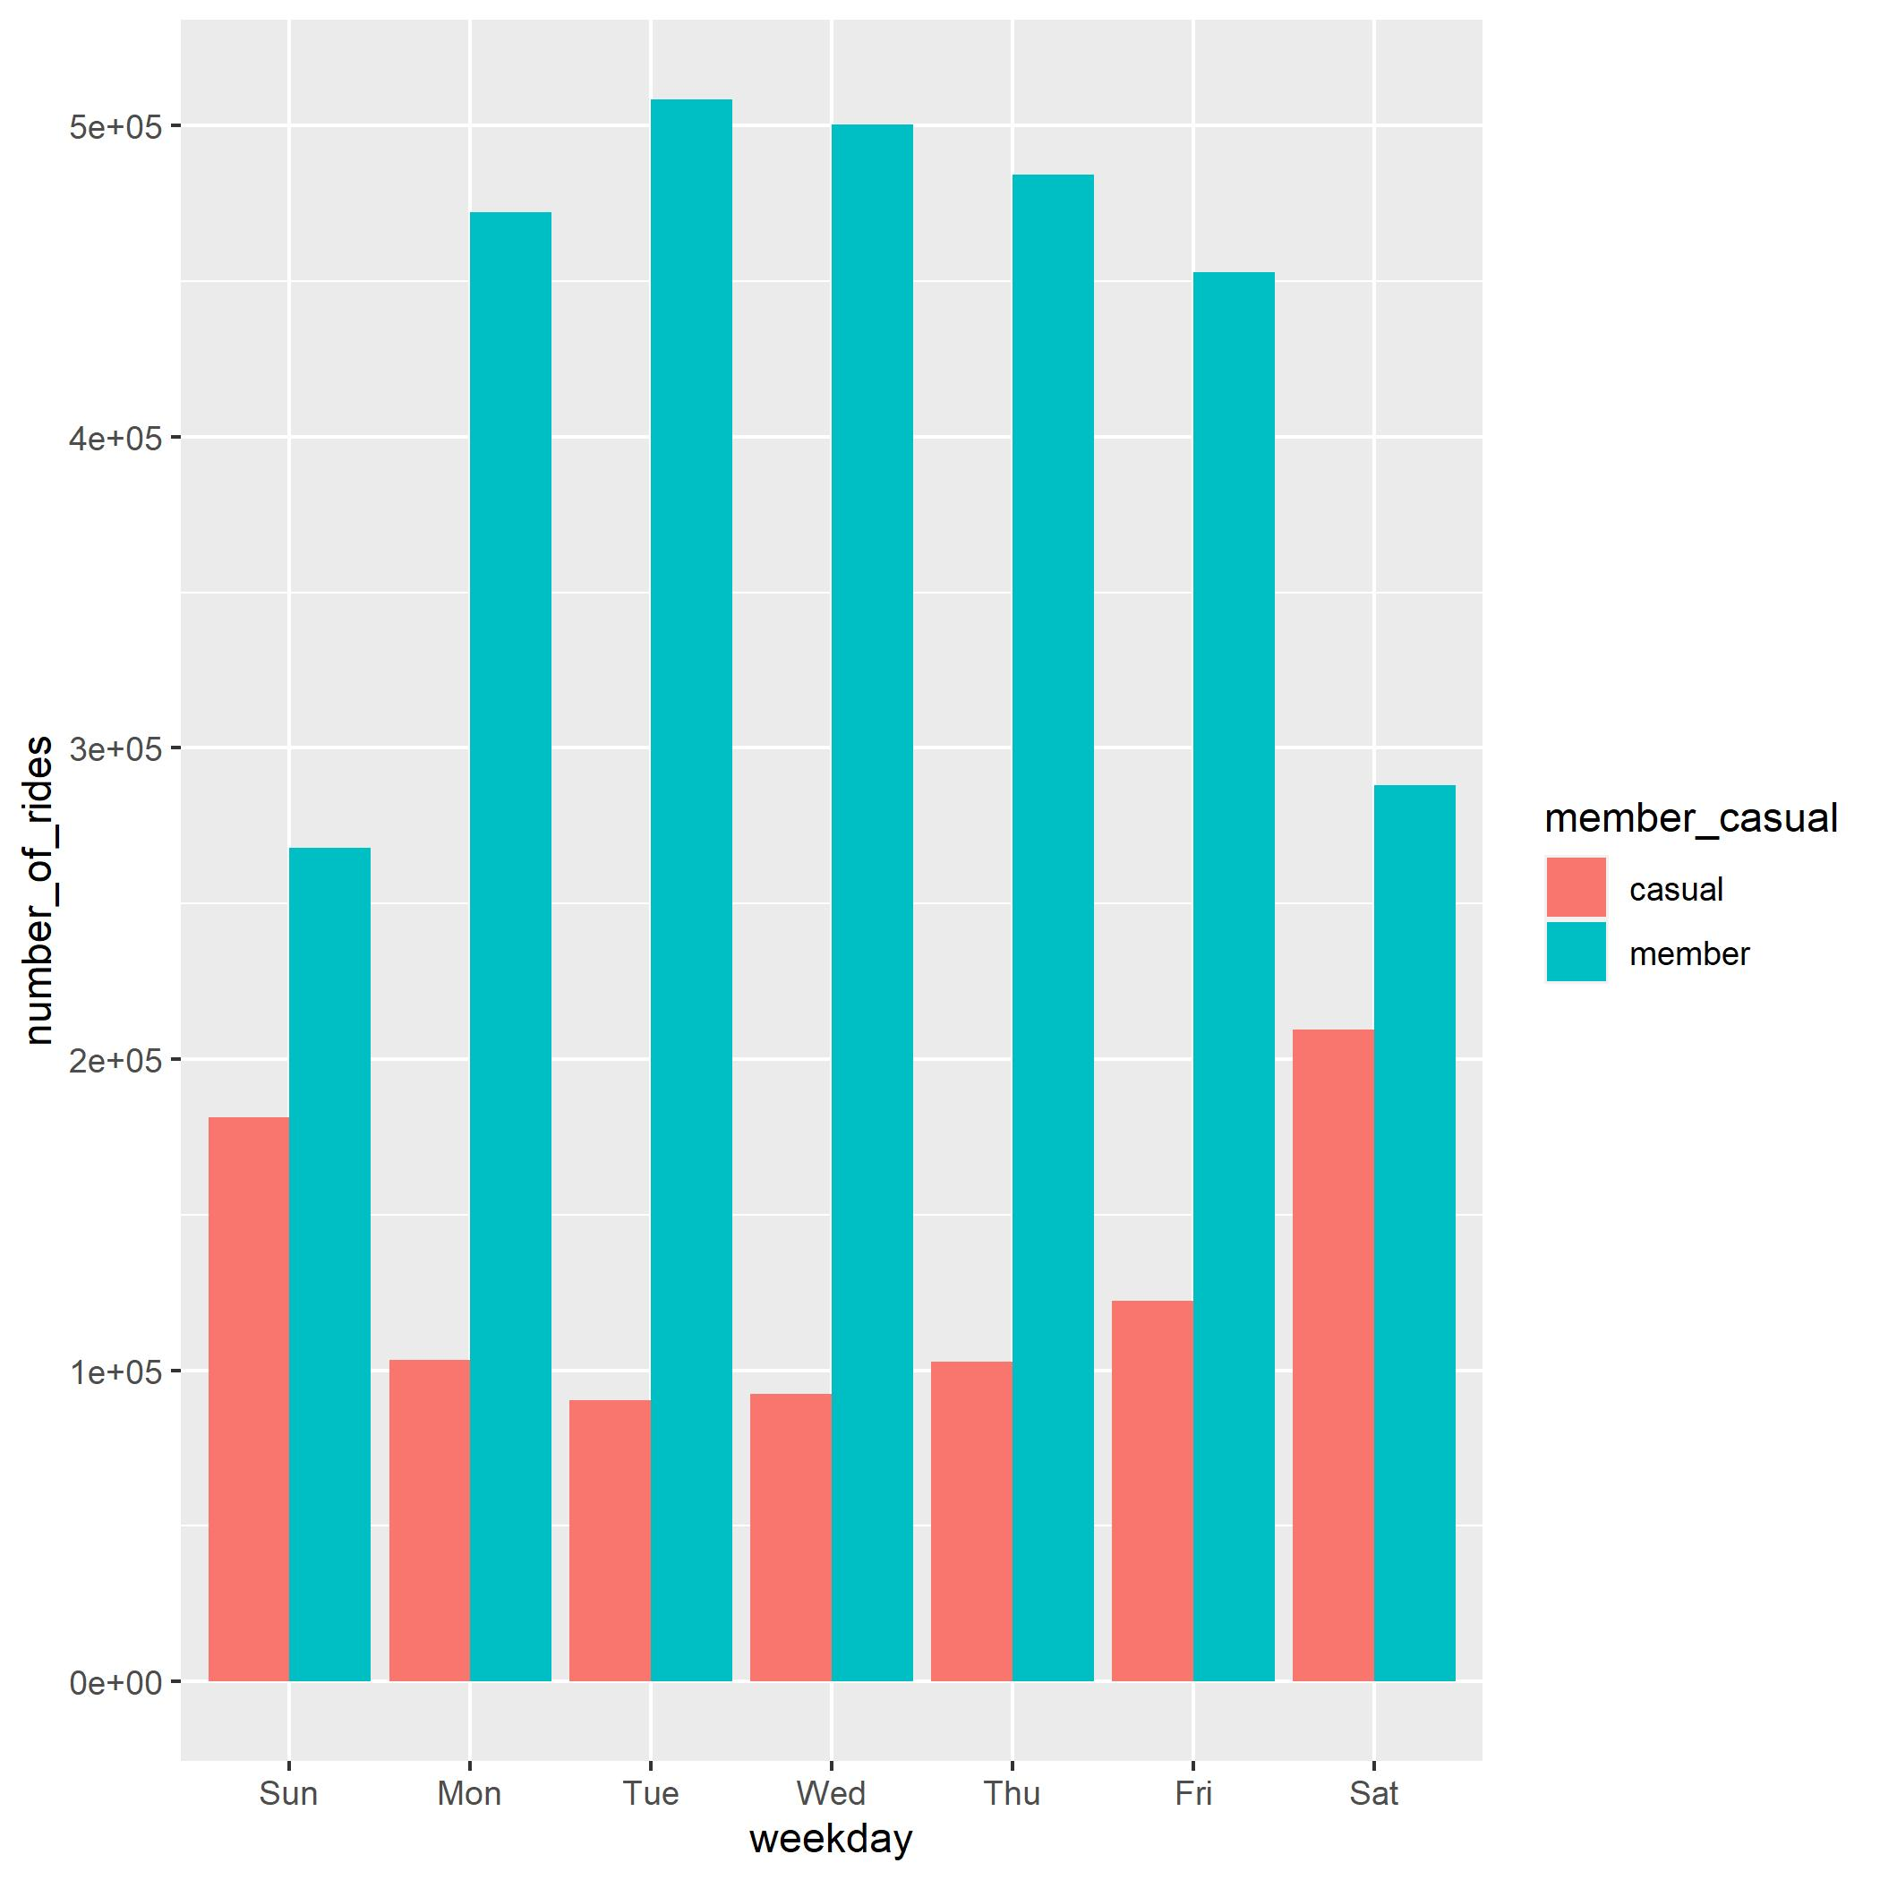
Number of rides by weekday
Annual members rides less on weekends.
Casual riders rides more on weekends.
On every weekday number of rides taken by members are greater than casual riders.

Slide 5
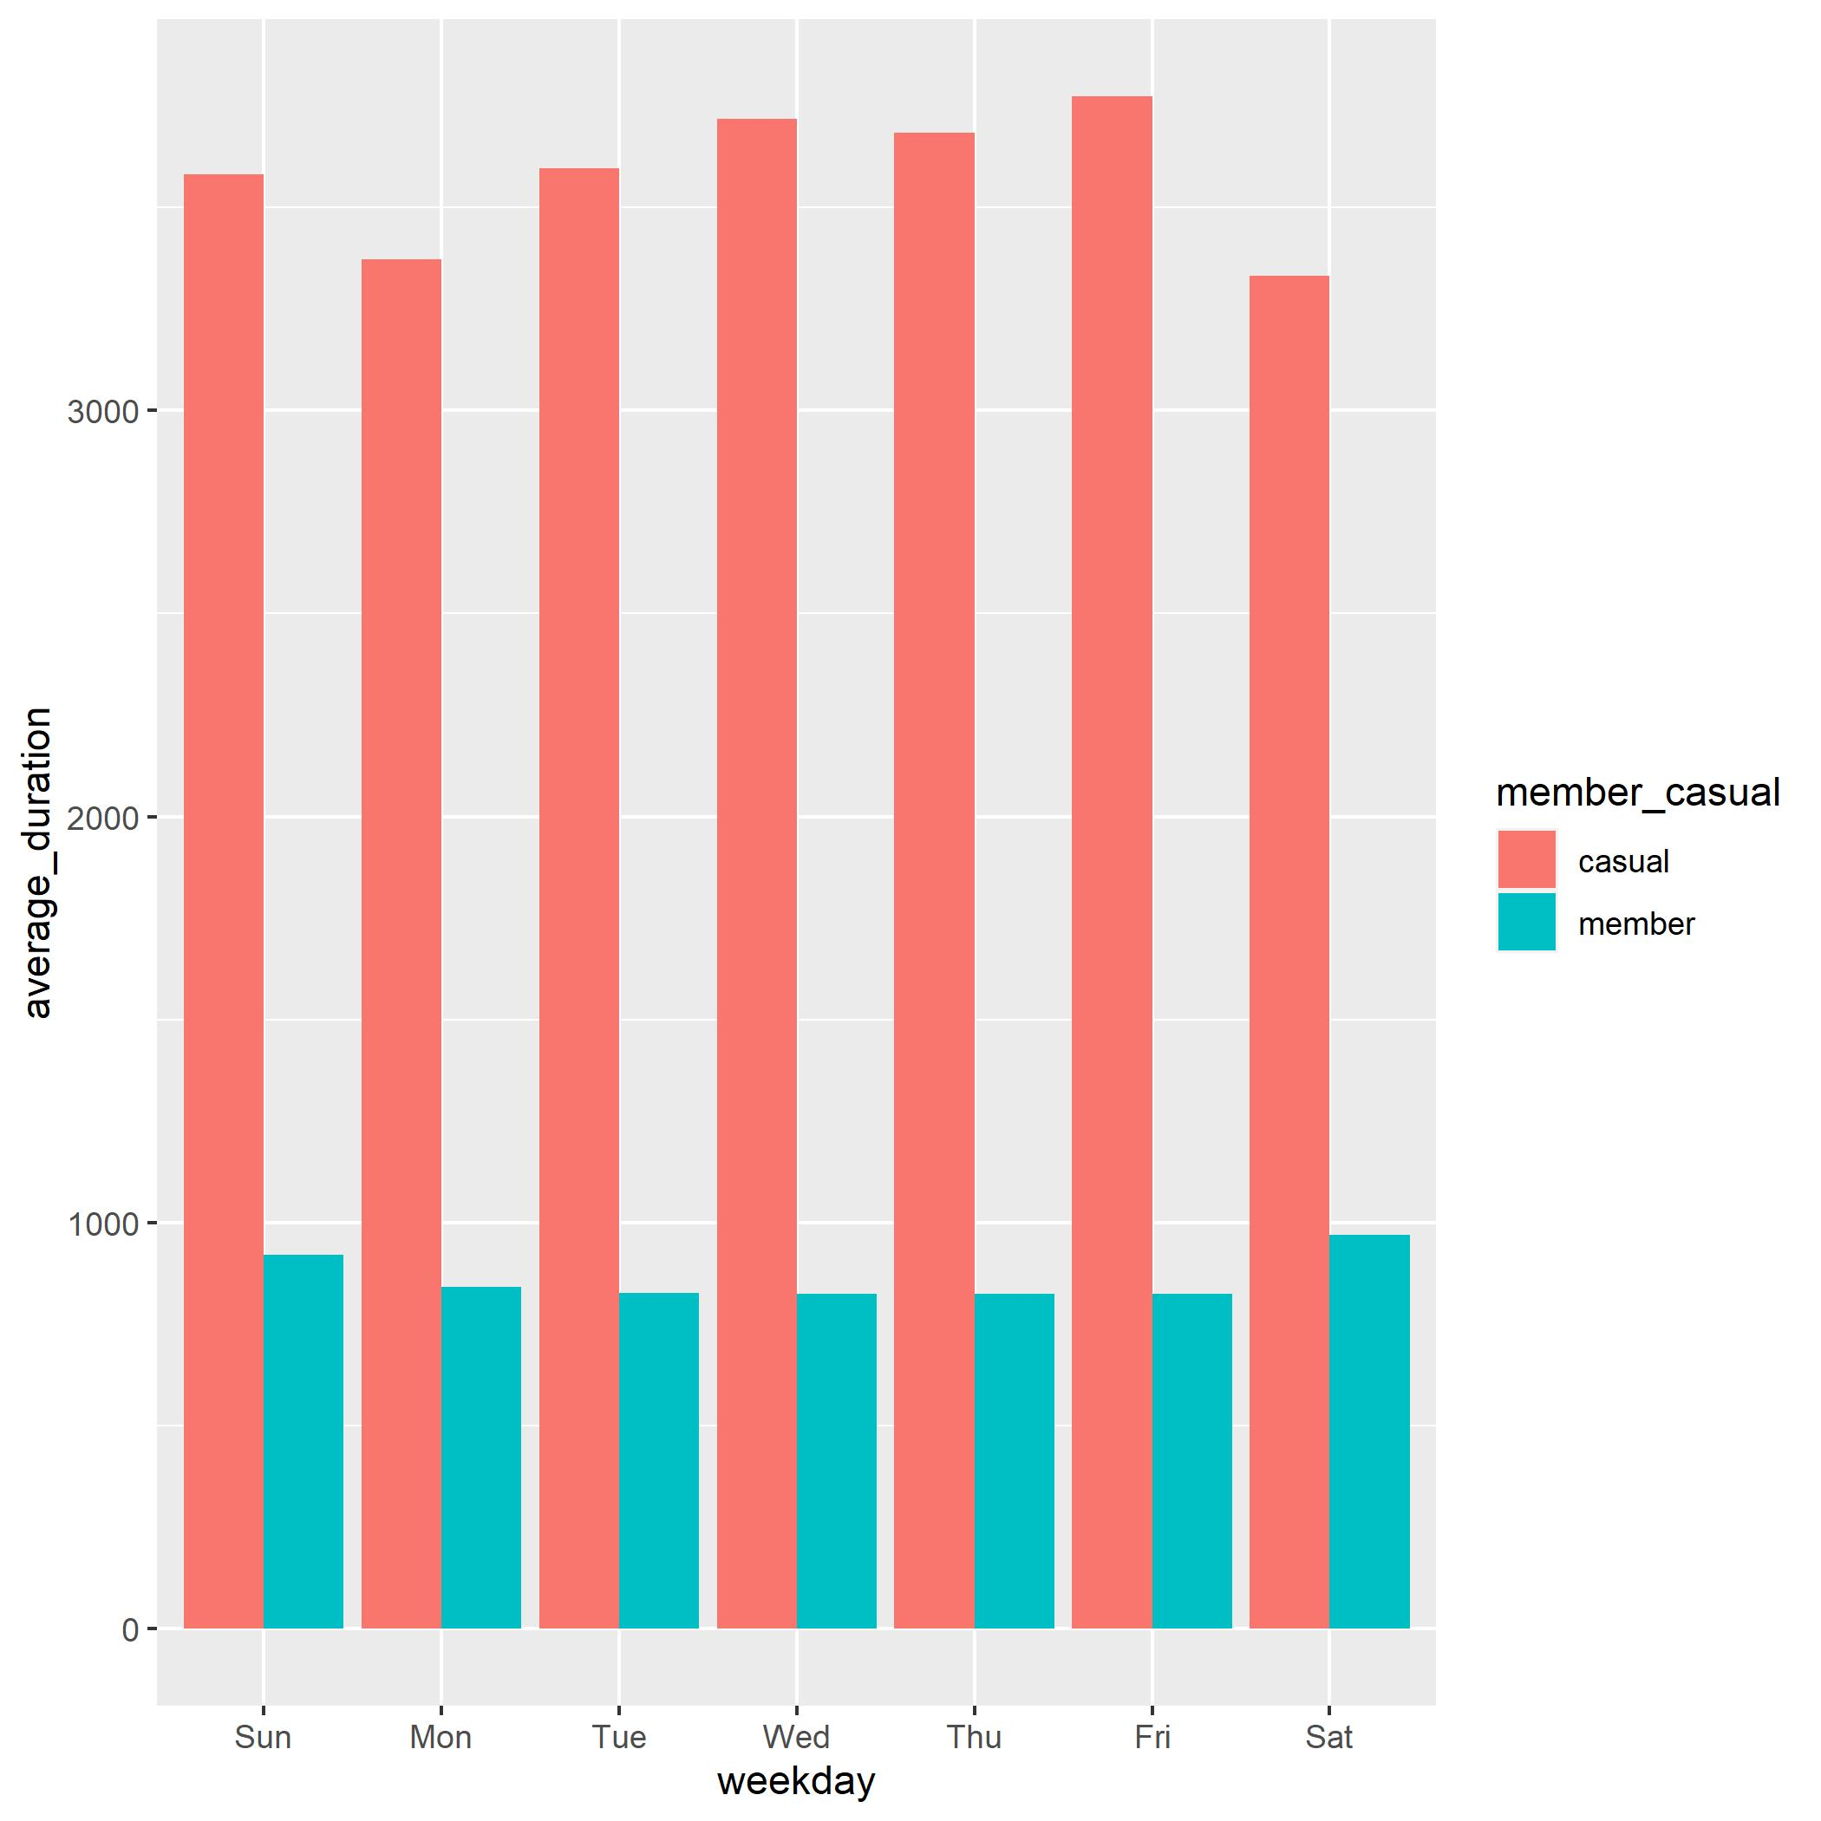
Average duration by weekday
On average casual riders ride way less than annual members on every weekday.
Average duration of members are still high on weekends even number of rides decreases.

Slide 6
Conclusion
Casual riders rides more bikes on weekends whereas annual rides more on work days
Average duration and number of rides by annual members are way more than casual members on everyday
Average duration of members are still high on weekends even number of rides decreases

Slide 7
THANK YOU

